Slide 1

Additional Charts Assignment
David Berberena
DSC 640 Data Presentation and Visualization
Weeks 5 and 6
7/14/24

Slide 2
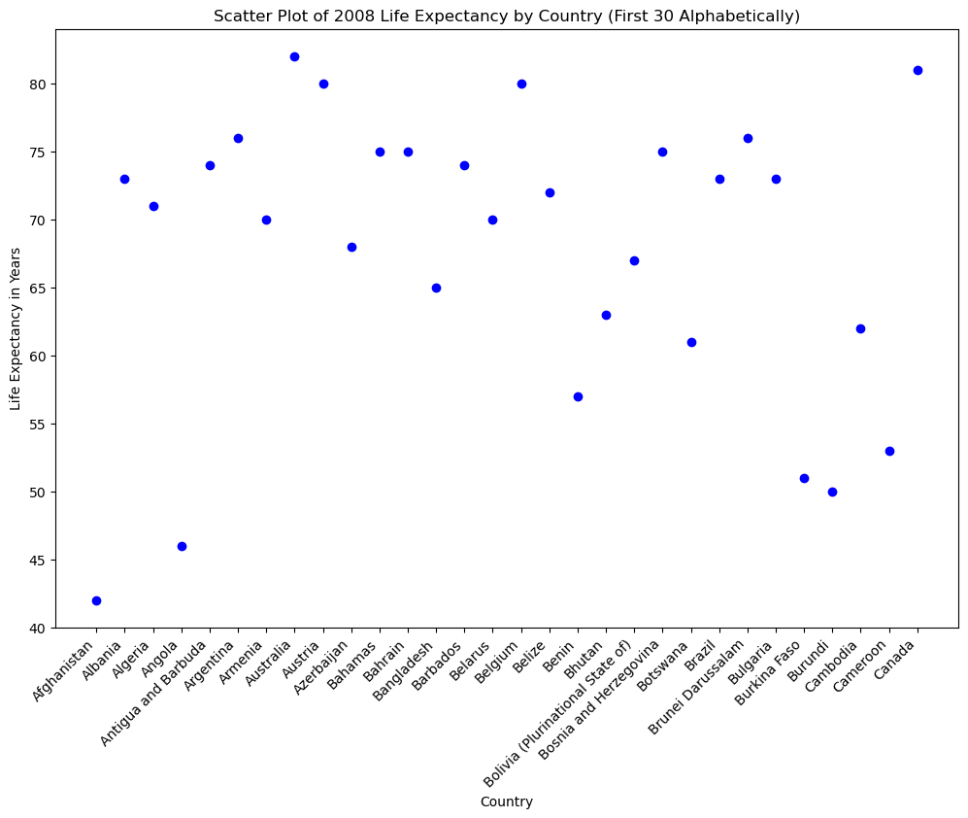
Python Scatter Plot

Slide 3
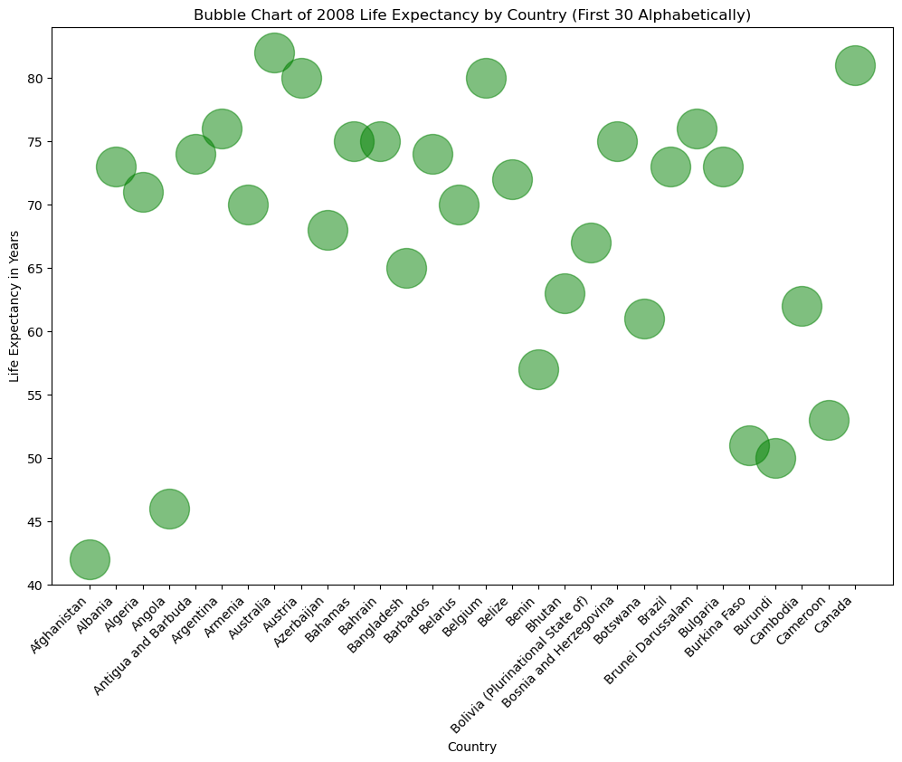
Python Bubble Chart

Slide 4
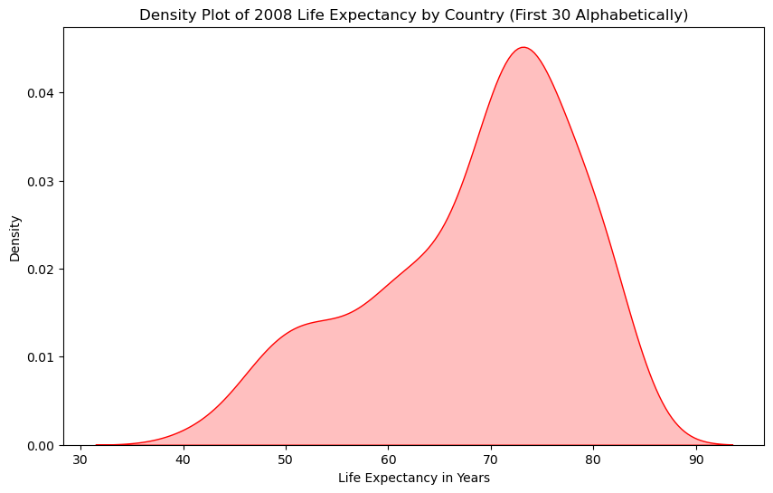
Python Density Plot

Slide 5
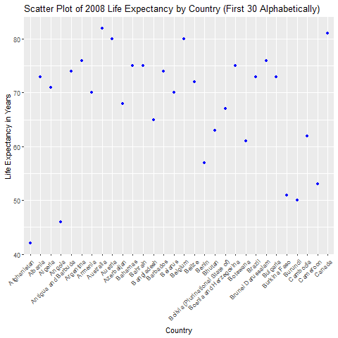
R Scatter Plot

Slide 6
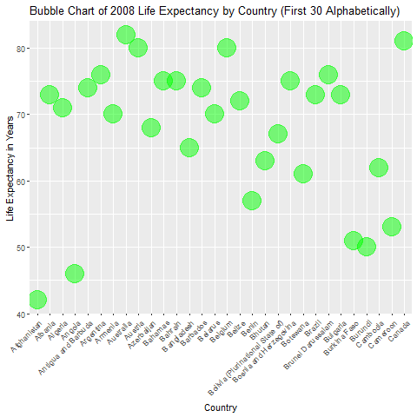
R Bubble Chart

Slide 7
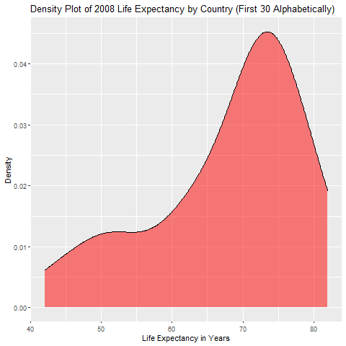
R Density Plot

Slide 8
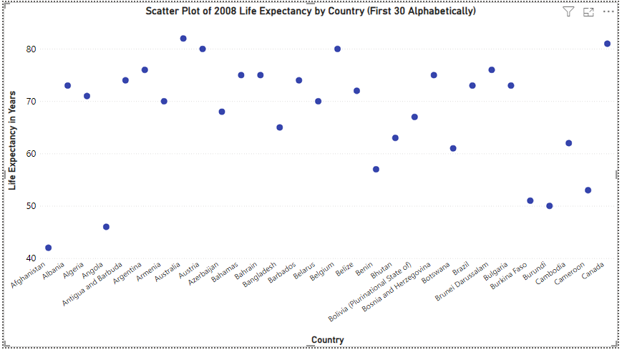
PowerBI Scatter Plot

Slide 9
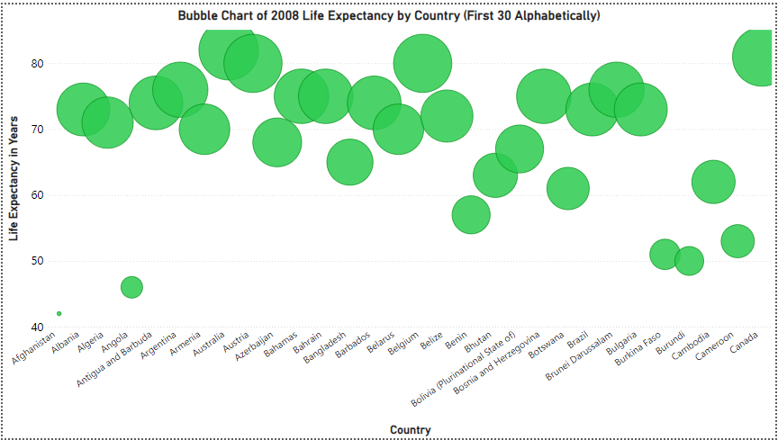
PowerBI Bubble Chart

Slide 10
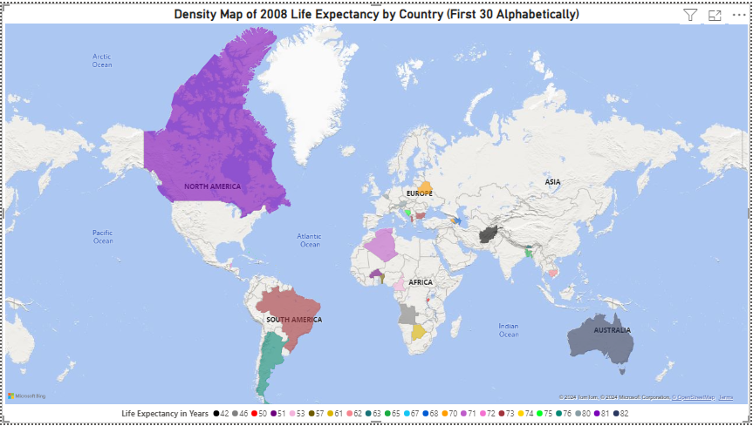
PowerBI Density Map

